Slide 1
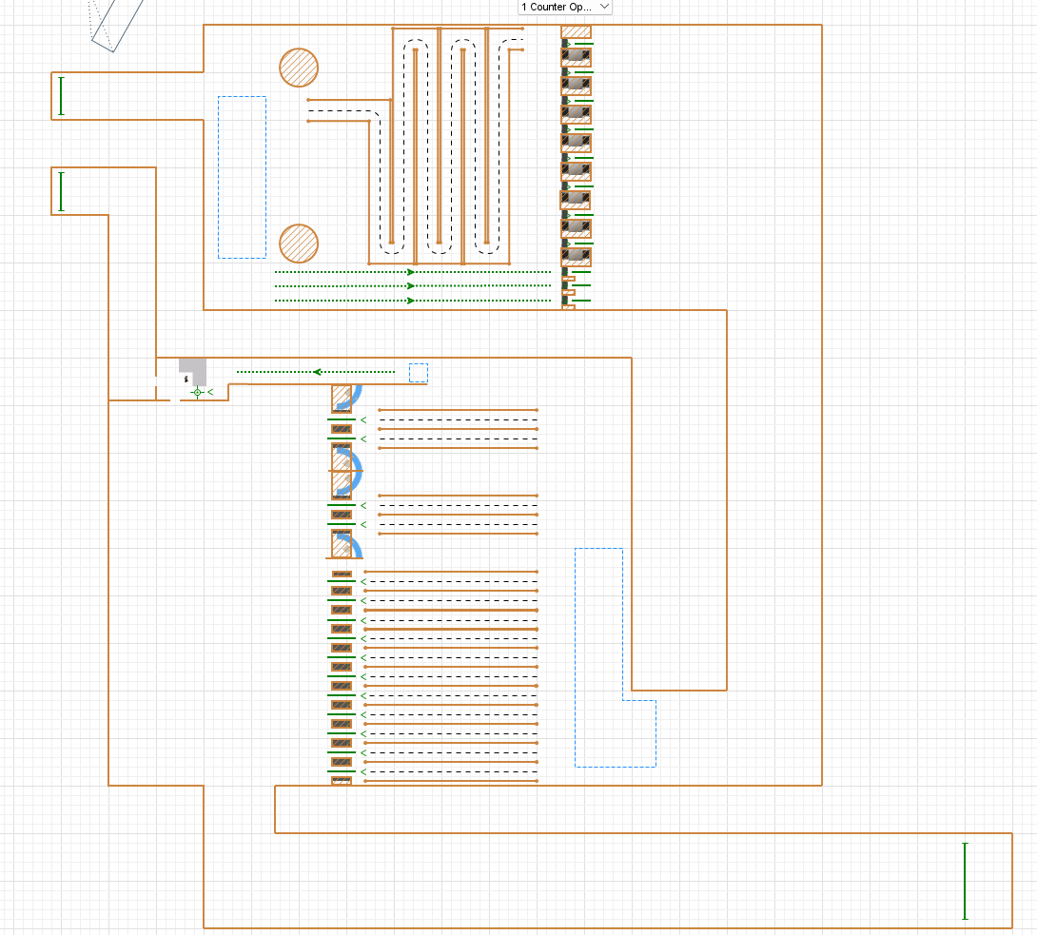
Simulation Design and assumptions
Assumptions
1All travellers must complete a Security Check in Phase
All travellers must complete a Passport Check in Phase
All travellers will spend Uniform 0-15 Seconds deciding which counter they want to go to before Phase 1 and Phase 2 (Decision making)
If a traveller fails the passport check, they will be sent to a referral counter to go through another check to decide if they are allowed to enter the country.
All checks use a base triangular distribution and will have a multiplier added to this time depending on their risk profile and or Document readiness
When a traveller is going through referral, they have a 50% chance of failing and being sent back.
All checks are done 1 traveller at a time. There is no group entry here.
1 Hour simulation is used on both setups.
Baggage Counters
No Baggage Counters
Manual Passport Counters
Referral Counter
Auto Passport Counters

Slide 2
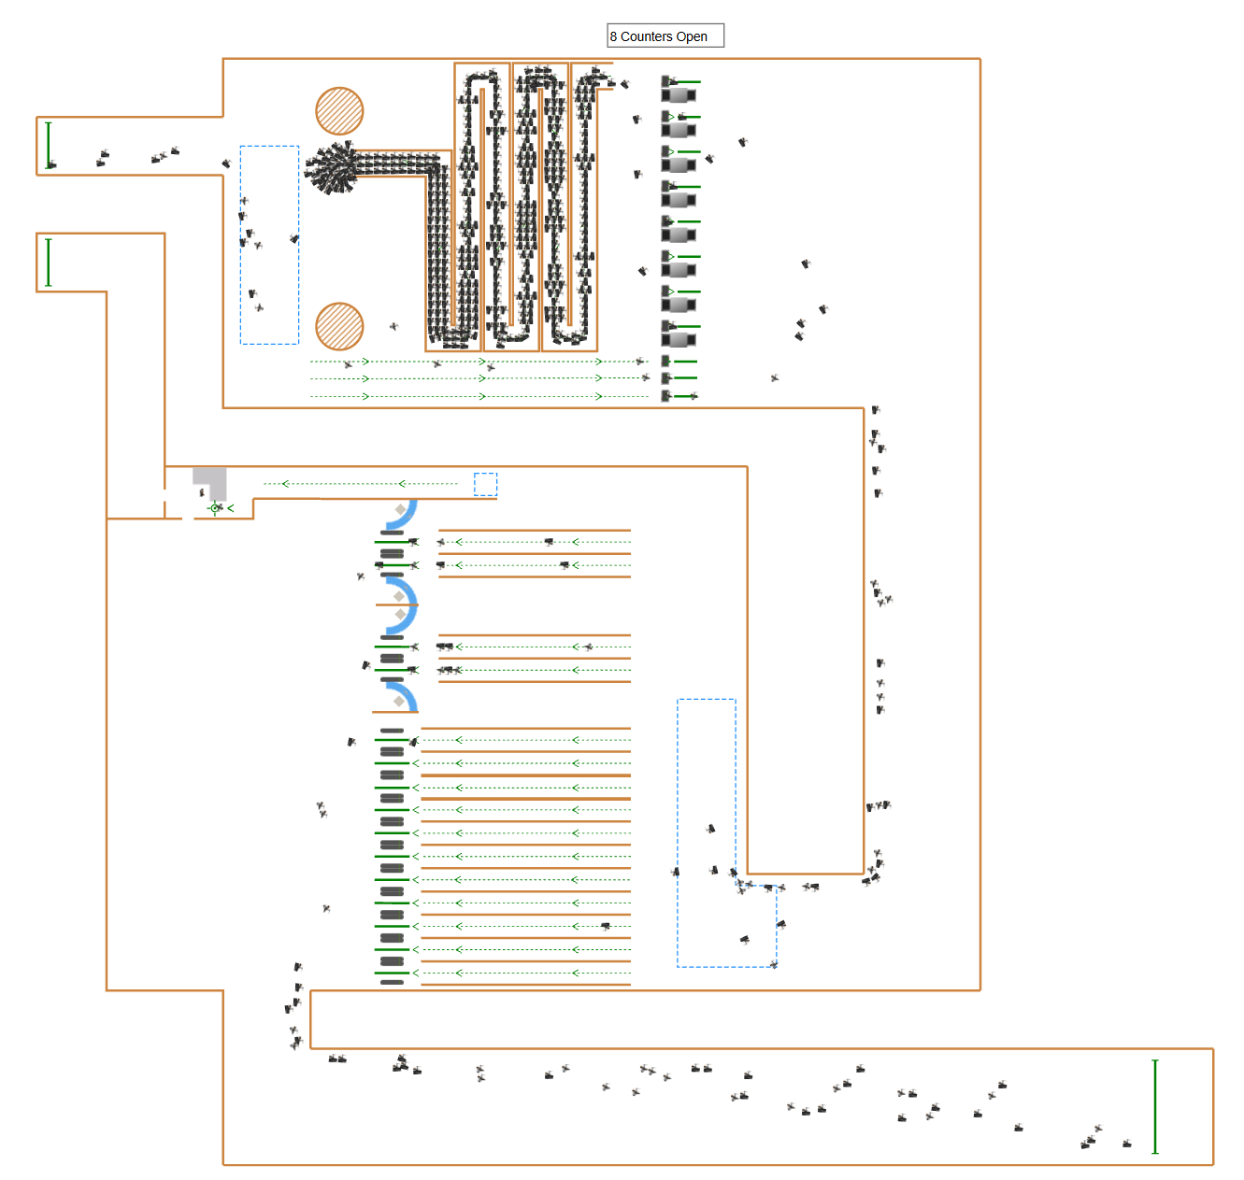
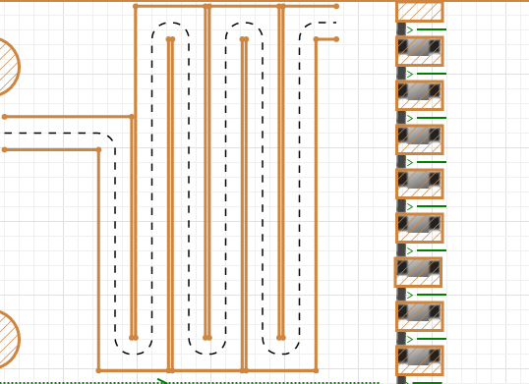
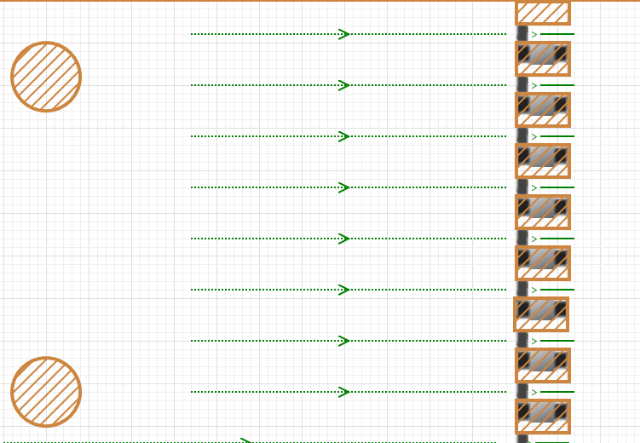
Problem overview
We Swapped the Serpentine queue line to 8 separate lines for each counter to see if this fixes our bottleneck
We are trying to use our built simulation to explore and evaluation operational effectiveness of our Simulation setup.
We observe that there is a several bottleneck at the Baggage Security Check Queue
Setup 1 | Setup 2

Slide 3
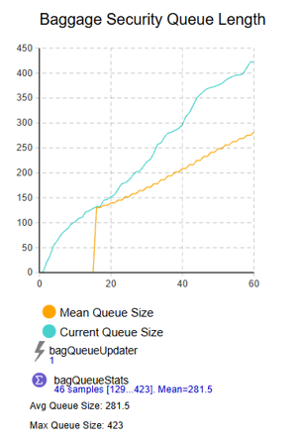
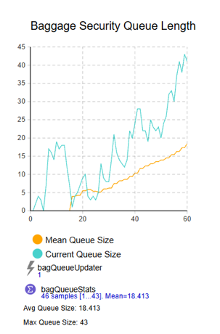
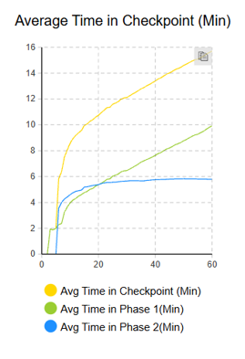
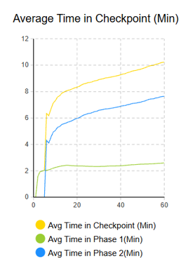
Comparison result of setup 1 vs setup 2
Queue Length Comparison
Average time in Checkpoint Analysis
Setup 1 | Setup 2
Setup 1 | Setup 2
We immediately see significant improvements for pedestrian flow. Dropping the average queue size from 281 to 18.
We also notice a considerable drop in the average time spent in phase 1. A more uniform average time spent rather than an increasing one due to the previous bottleneck. Average overall Time spent also improves with it peaking at 10min rather than 16min. However, we also observe that Phase 2’s performance dropped due to more travellers making it through phase 1.

Slide 4
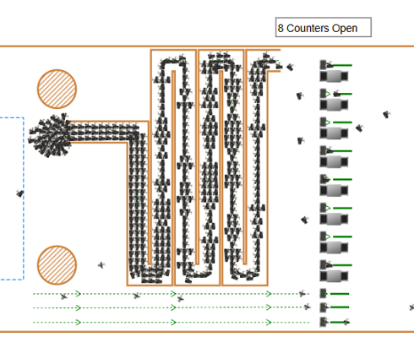
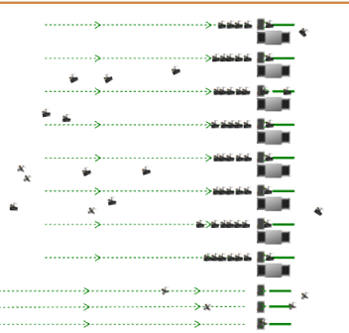
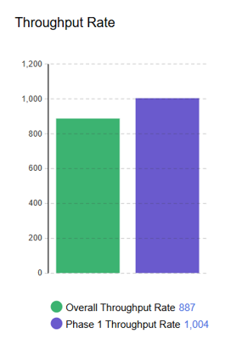
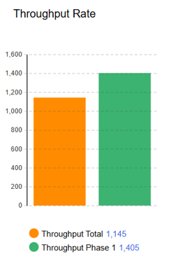
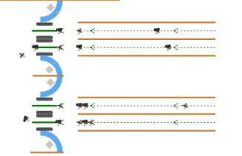
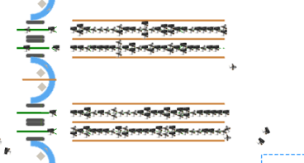
Comparison result of setup 1 vs setup 2
Bottleneck Analysis
Throughput analysis
Setup 1 | Setup 2
Setup 1 | Setup 2
Our throughput rate also improves. Increasing phase 1 Throughput by 401 and the overall throughput by 258. Overall Setup 2 performs better than setup 1 by around 30%. This can be further improved by addressing the Manual passport counters bottleneck.
We now notice that the bottleneck has shifted over to the Manual Passport Counters from the graphical visualization of our simulation and the average time spent comparison.

Slide 5
Recommendations and operational insights
Start to use use Setup 2 as our baseline as it is significantly better than Setup 1.
As we have identified another bottleneck due to swapping over to Setup 2. We could reduce the amount of auto counters and increase the amount of manual counters. However, this could cause additional staffing requirements.
Another improvement that we can try is to lower the amount of Counters for baggage Security check which will lower the staffing requirement as well as lower the throughput output for phase 1.

